Slide 1



financials (tables)
View in Power BI
Last data refresh:
1/14/2026 8:41:29 PM UTC
Downloaded at:
1/15/2026 7:56:39 PM UTC

Slide 2
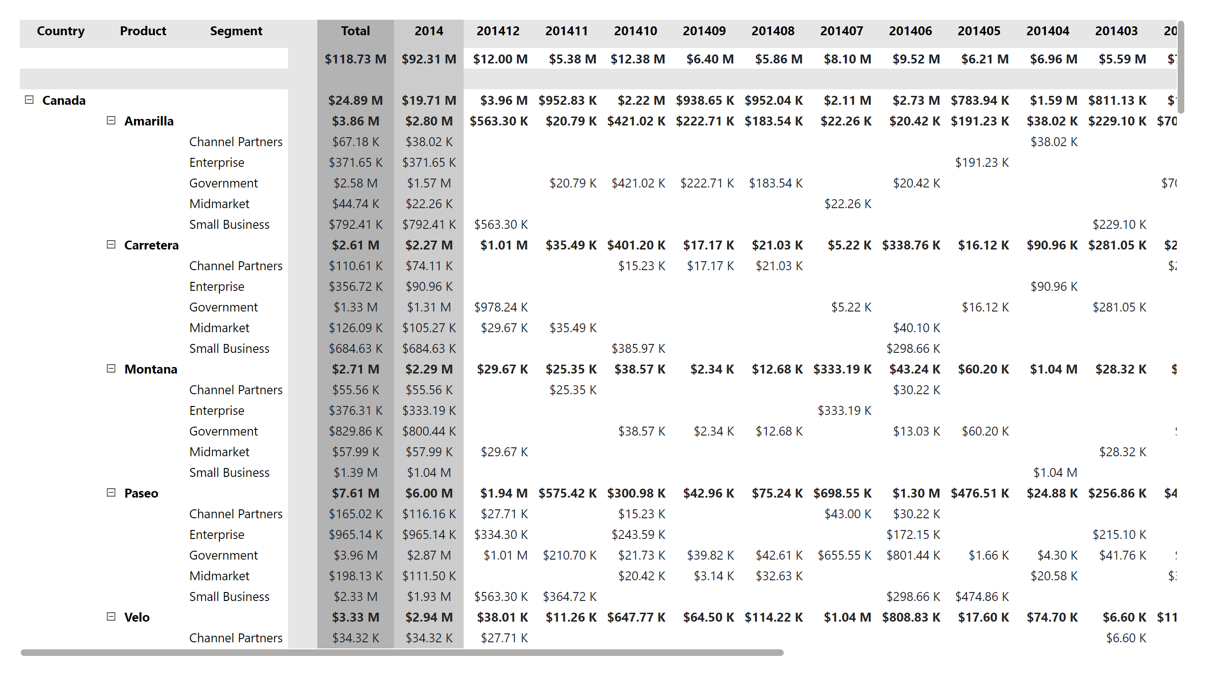
Month
Notes:
pivotTable
No alt text provided

Slide 3
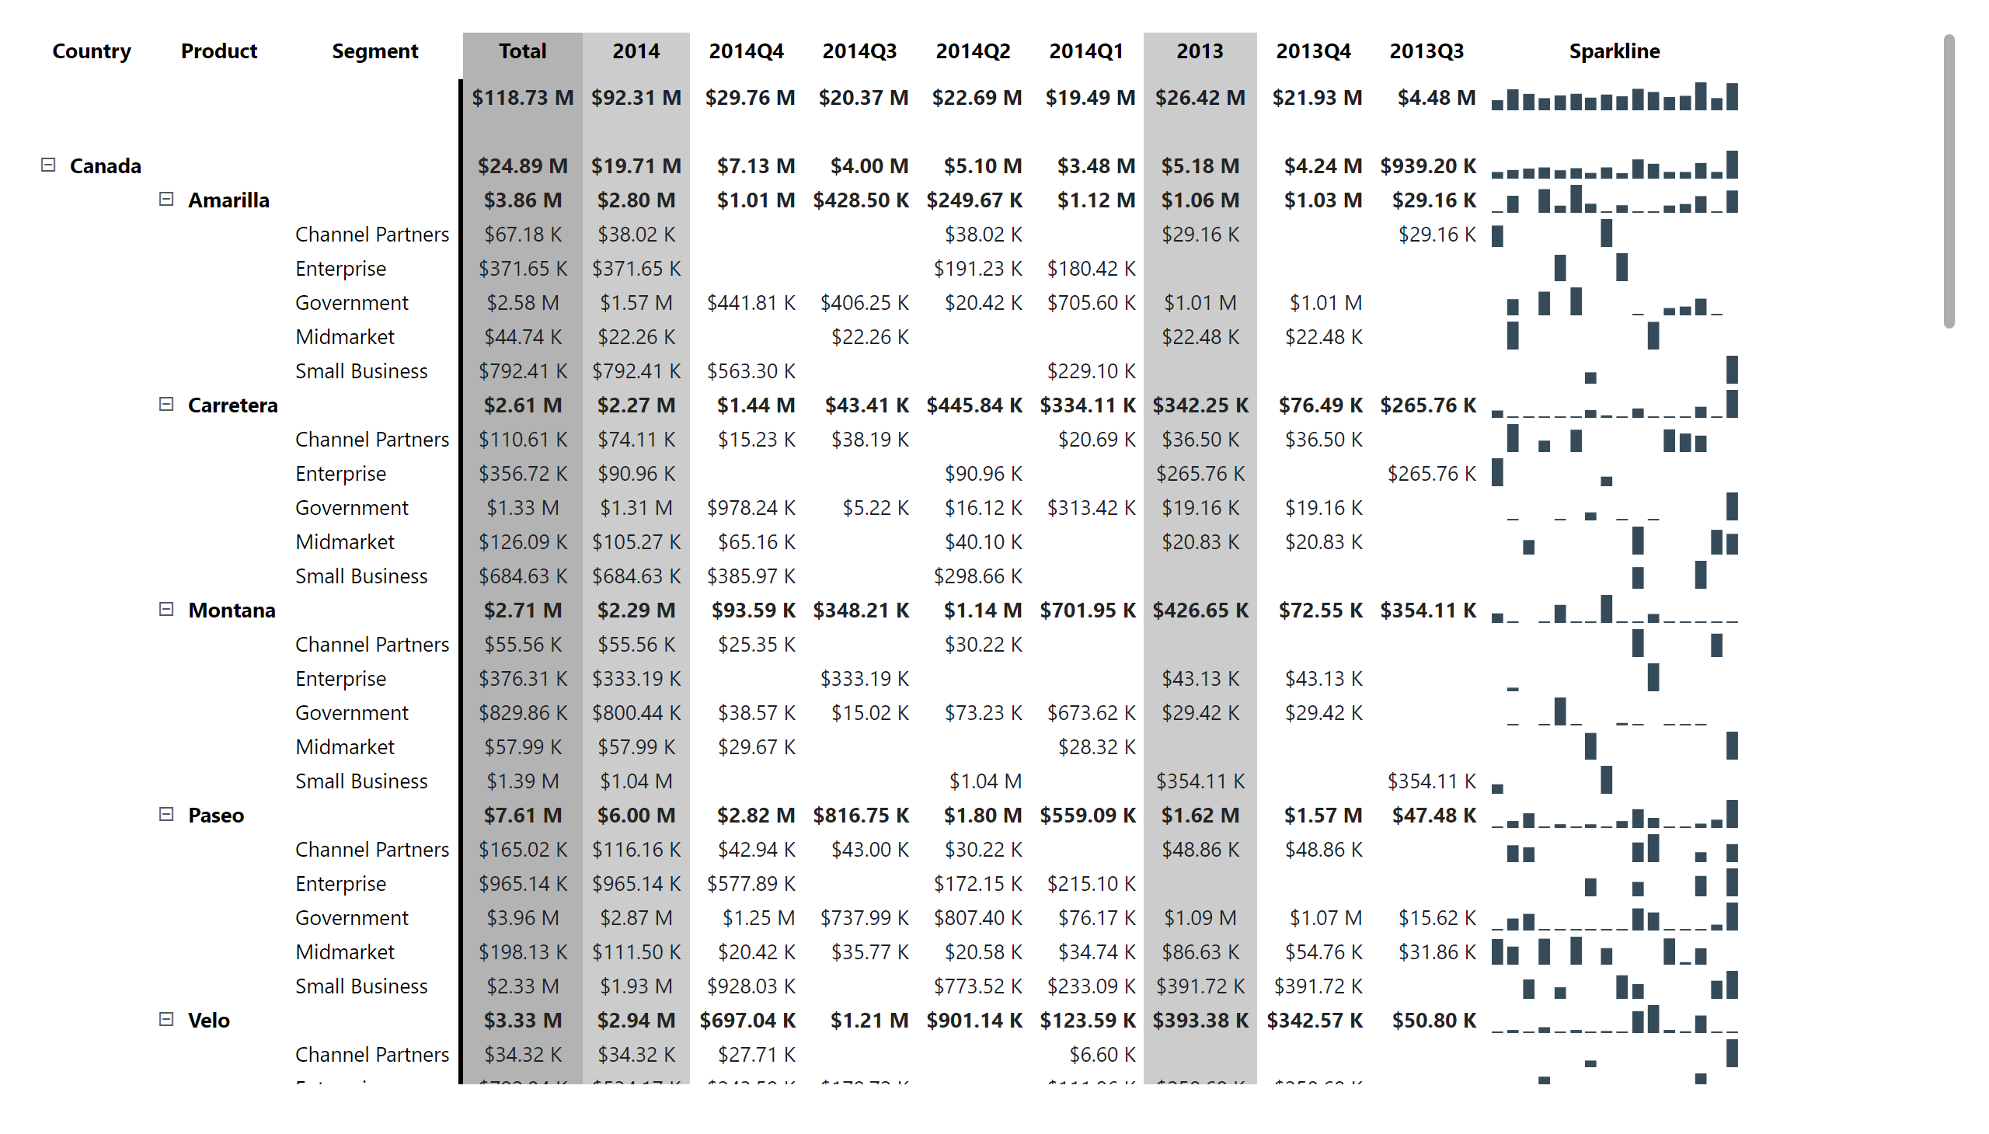
Quarter
Notes:
pivotTable
No alt text provided

Slide 4
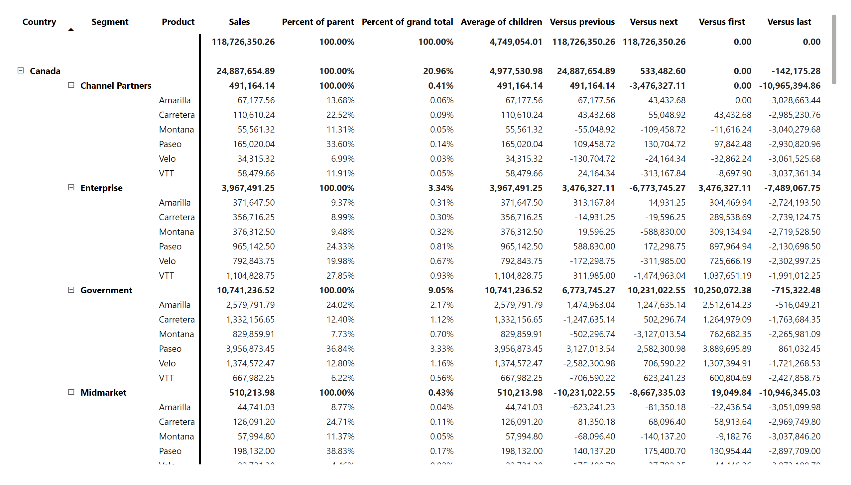
Visual calculations (Product)
Notes:
pivotTable
No alt text provided

Slide 5
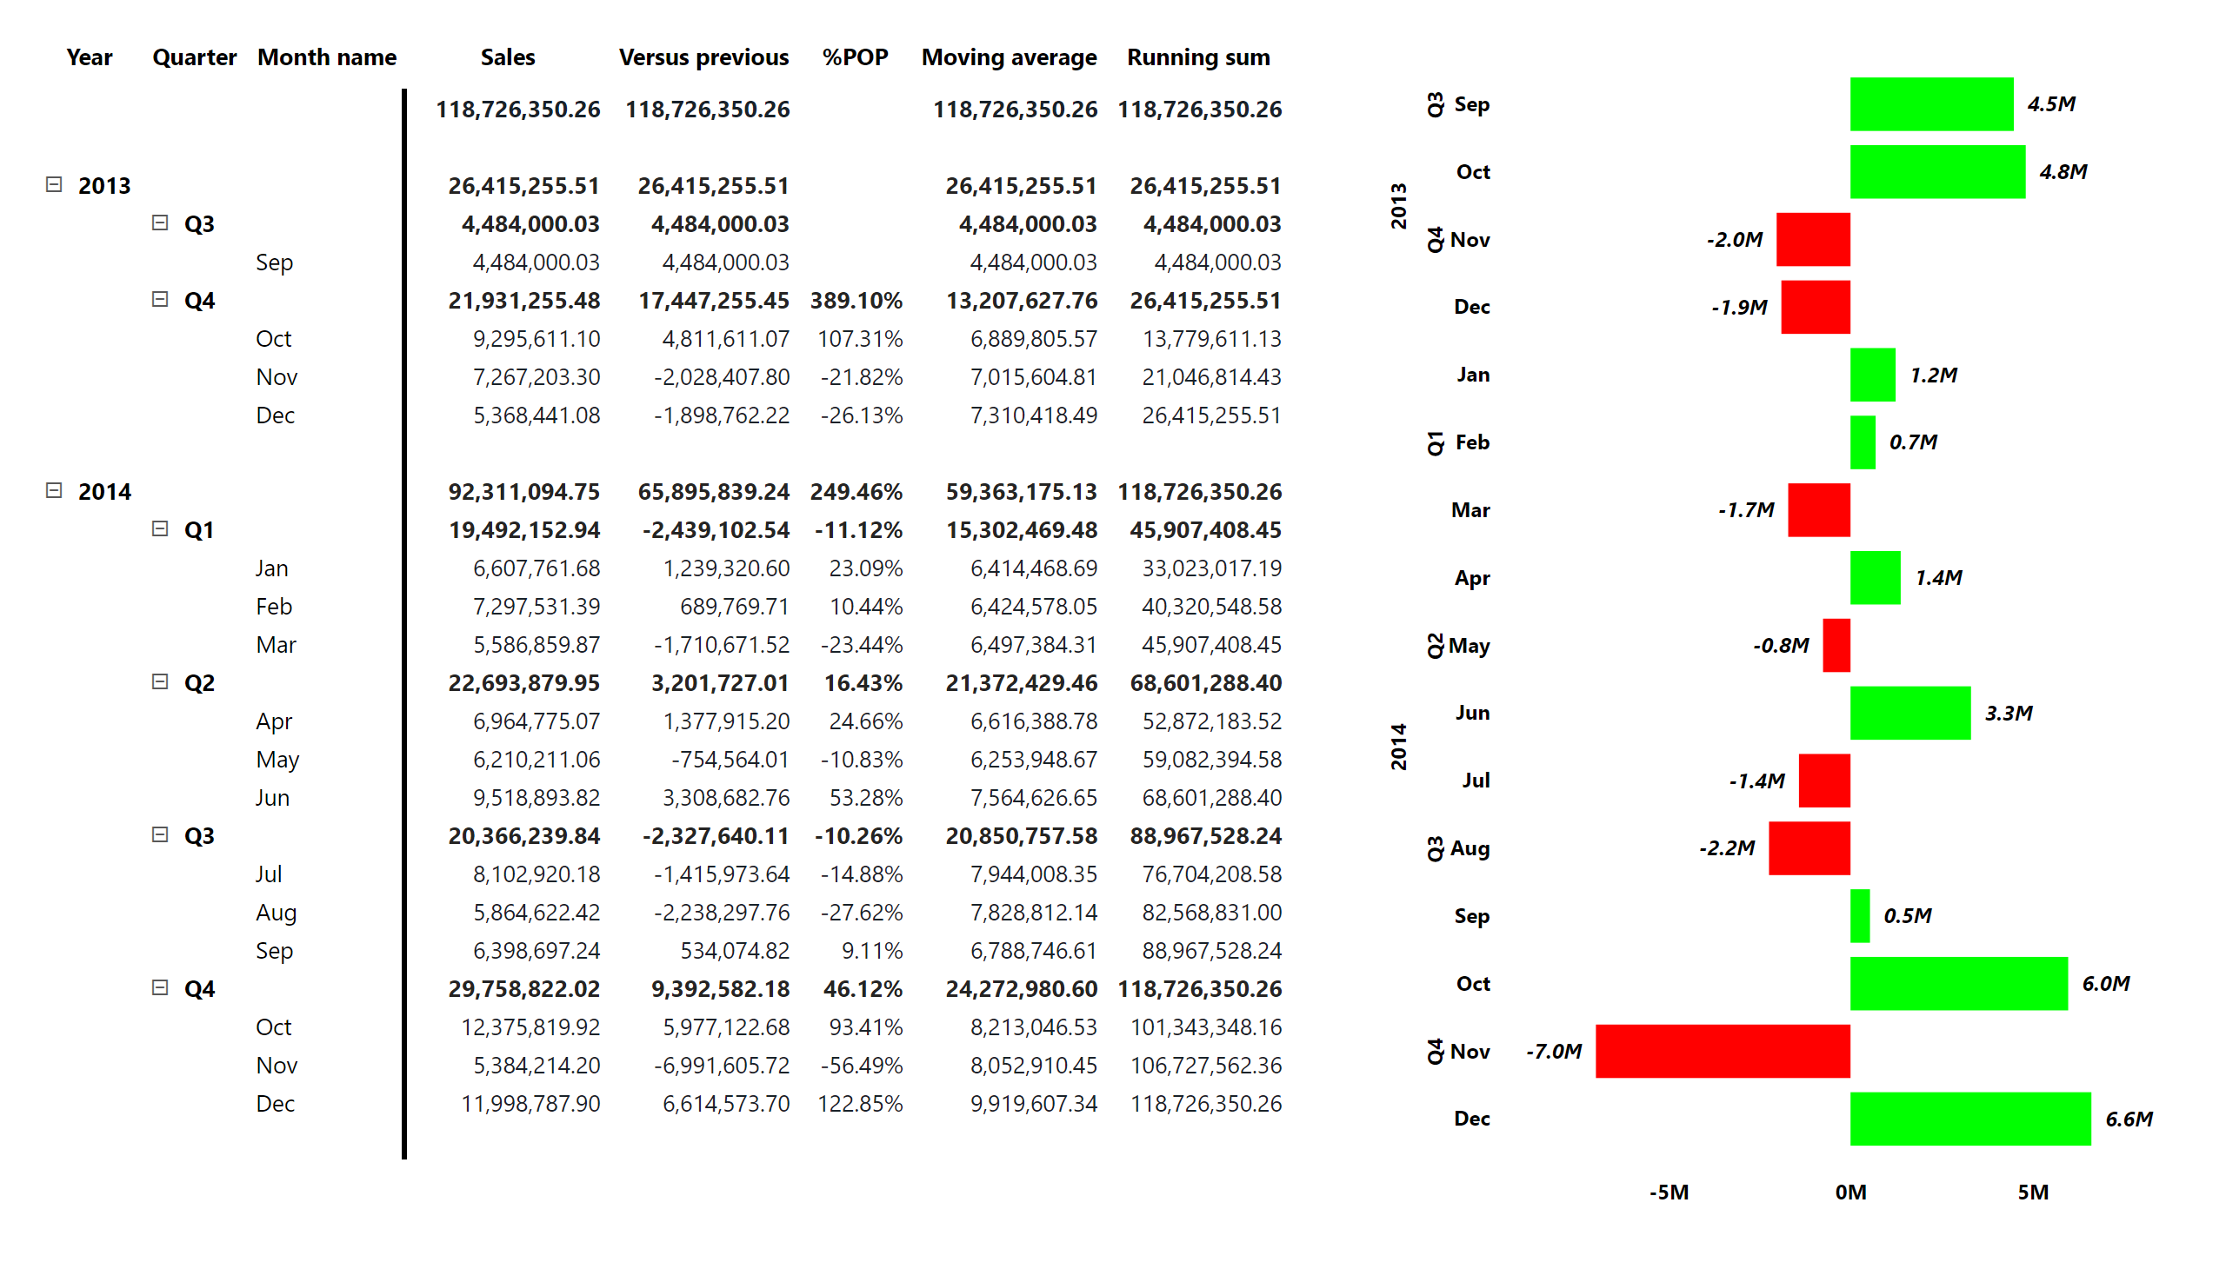
Visual calculations (Dates)
Notes:
clusteredBarChart
Clustered bar chart
pivotTable
No alt text provided

Slide 6
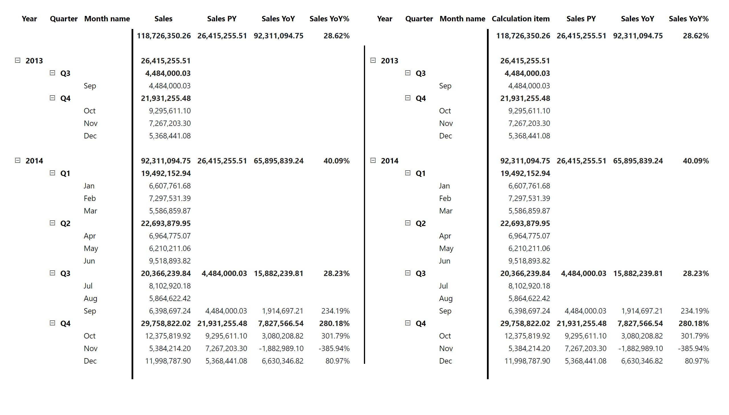
Calculation group
Notes:
pivotTable
No alt text provided
shape
No alt text provided
pivotTable
No alt text provided

Slide 7
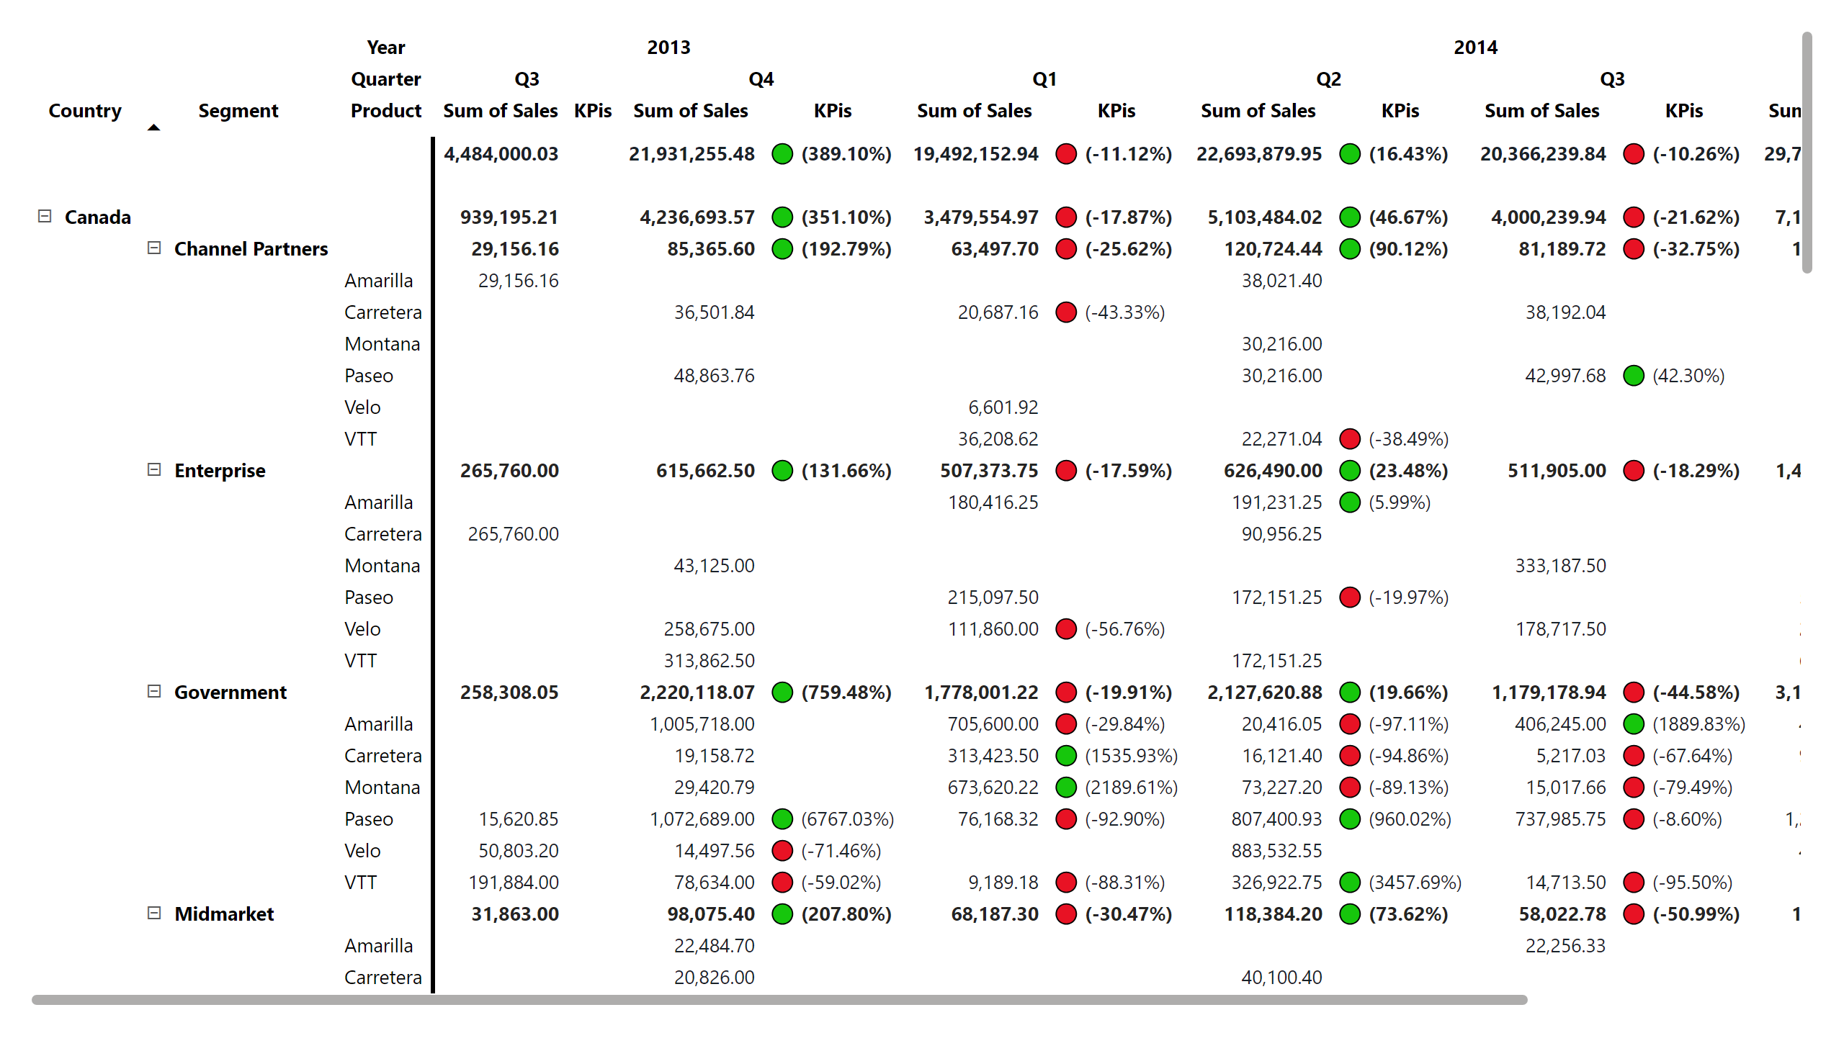
KPIs
Notes:
pivotTable
No alt text provided

Slide 8
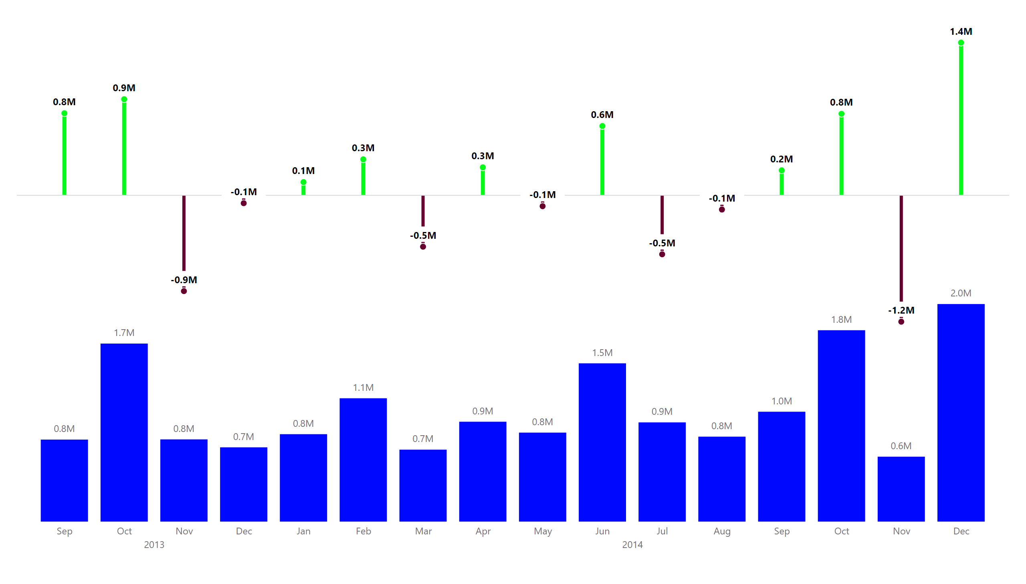
Variance
Notes:
clusteredColumnChart
No alt text provided

Slide 9
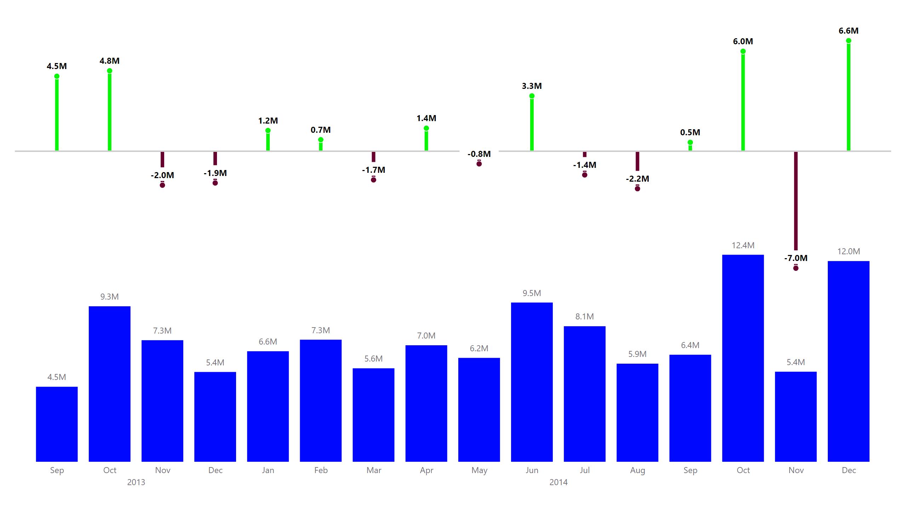
SVariance
Notes:
clusteredColumnChart
No alt text provided

Slide 10
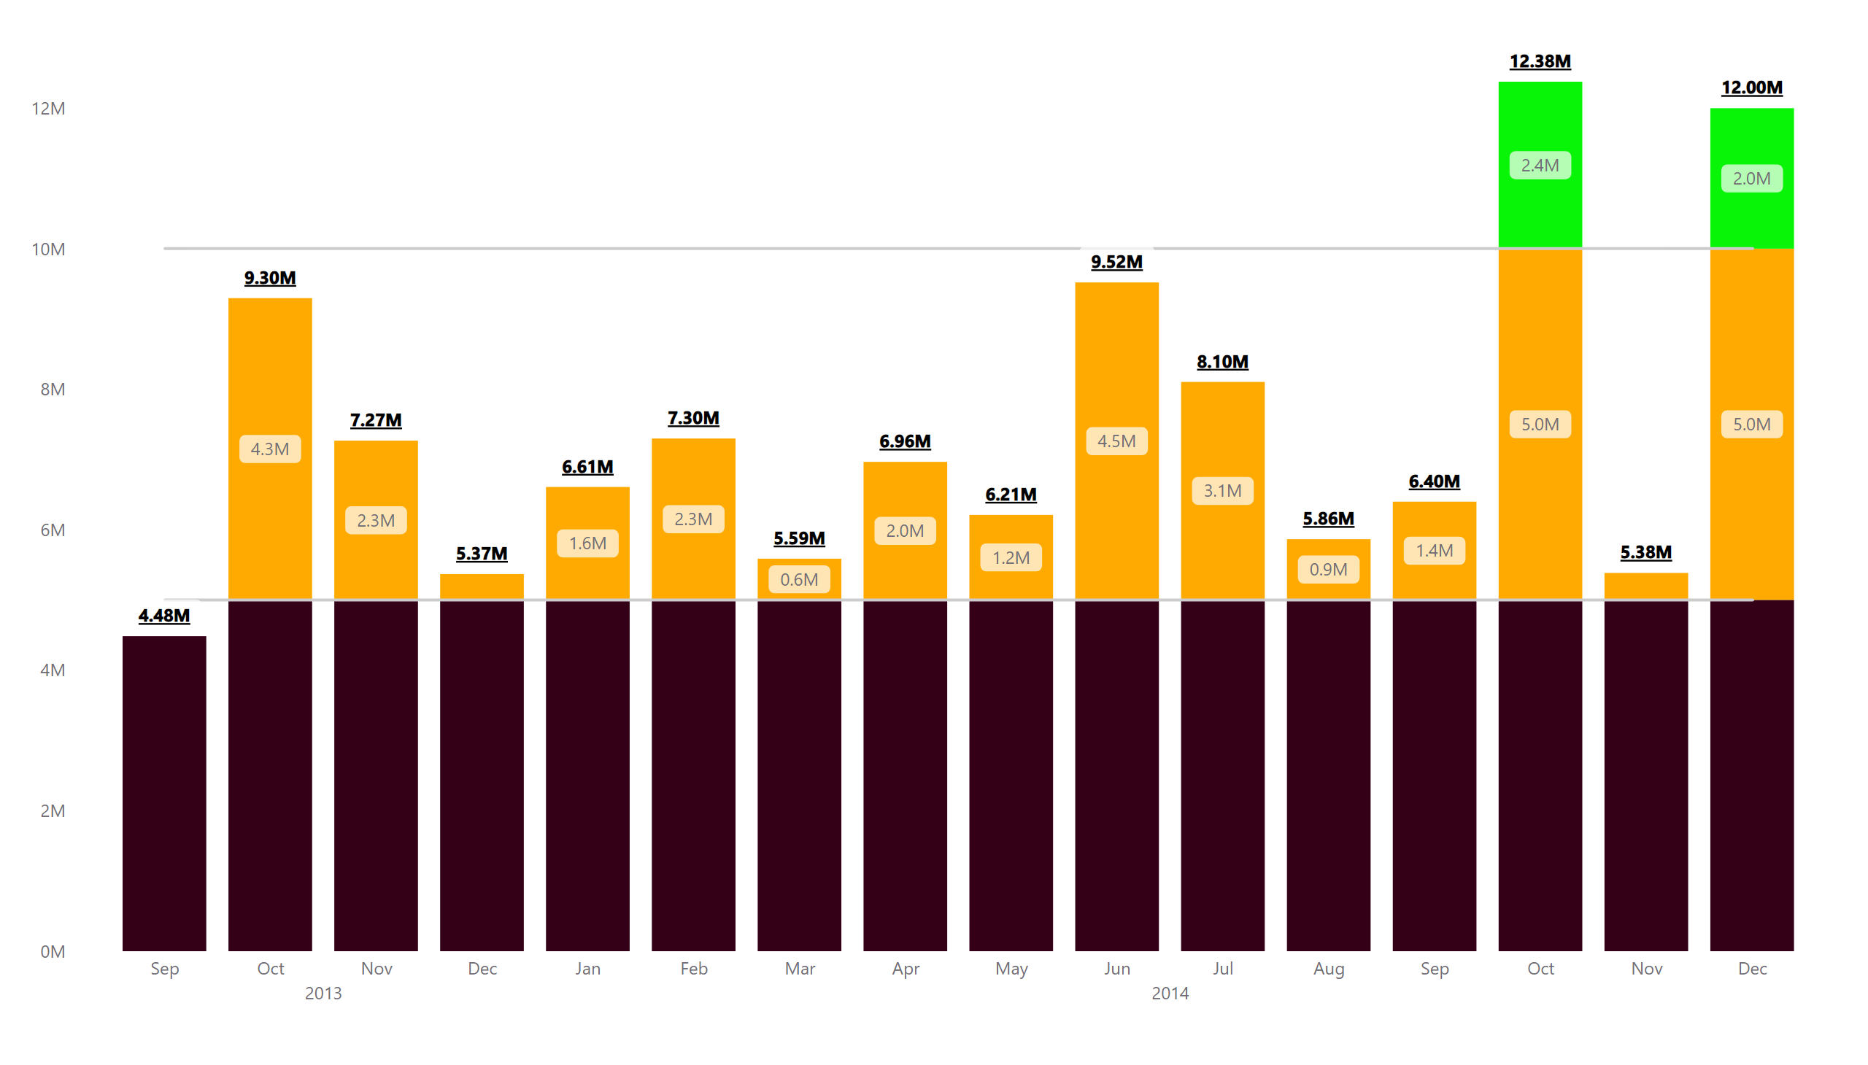
Bar Chart Makeover
Notes:
lineStackedColumnComboChart
No alt text provided

Slide 11
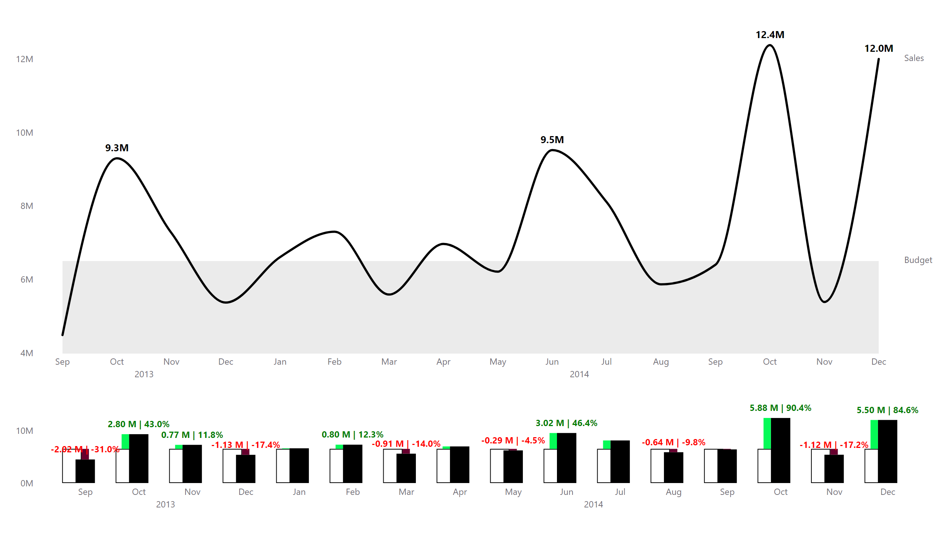
IBCS
Notes:
clusteredColumnChart
No alt text provided
lineChart
No alt text provided

Slide 12
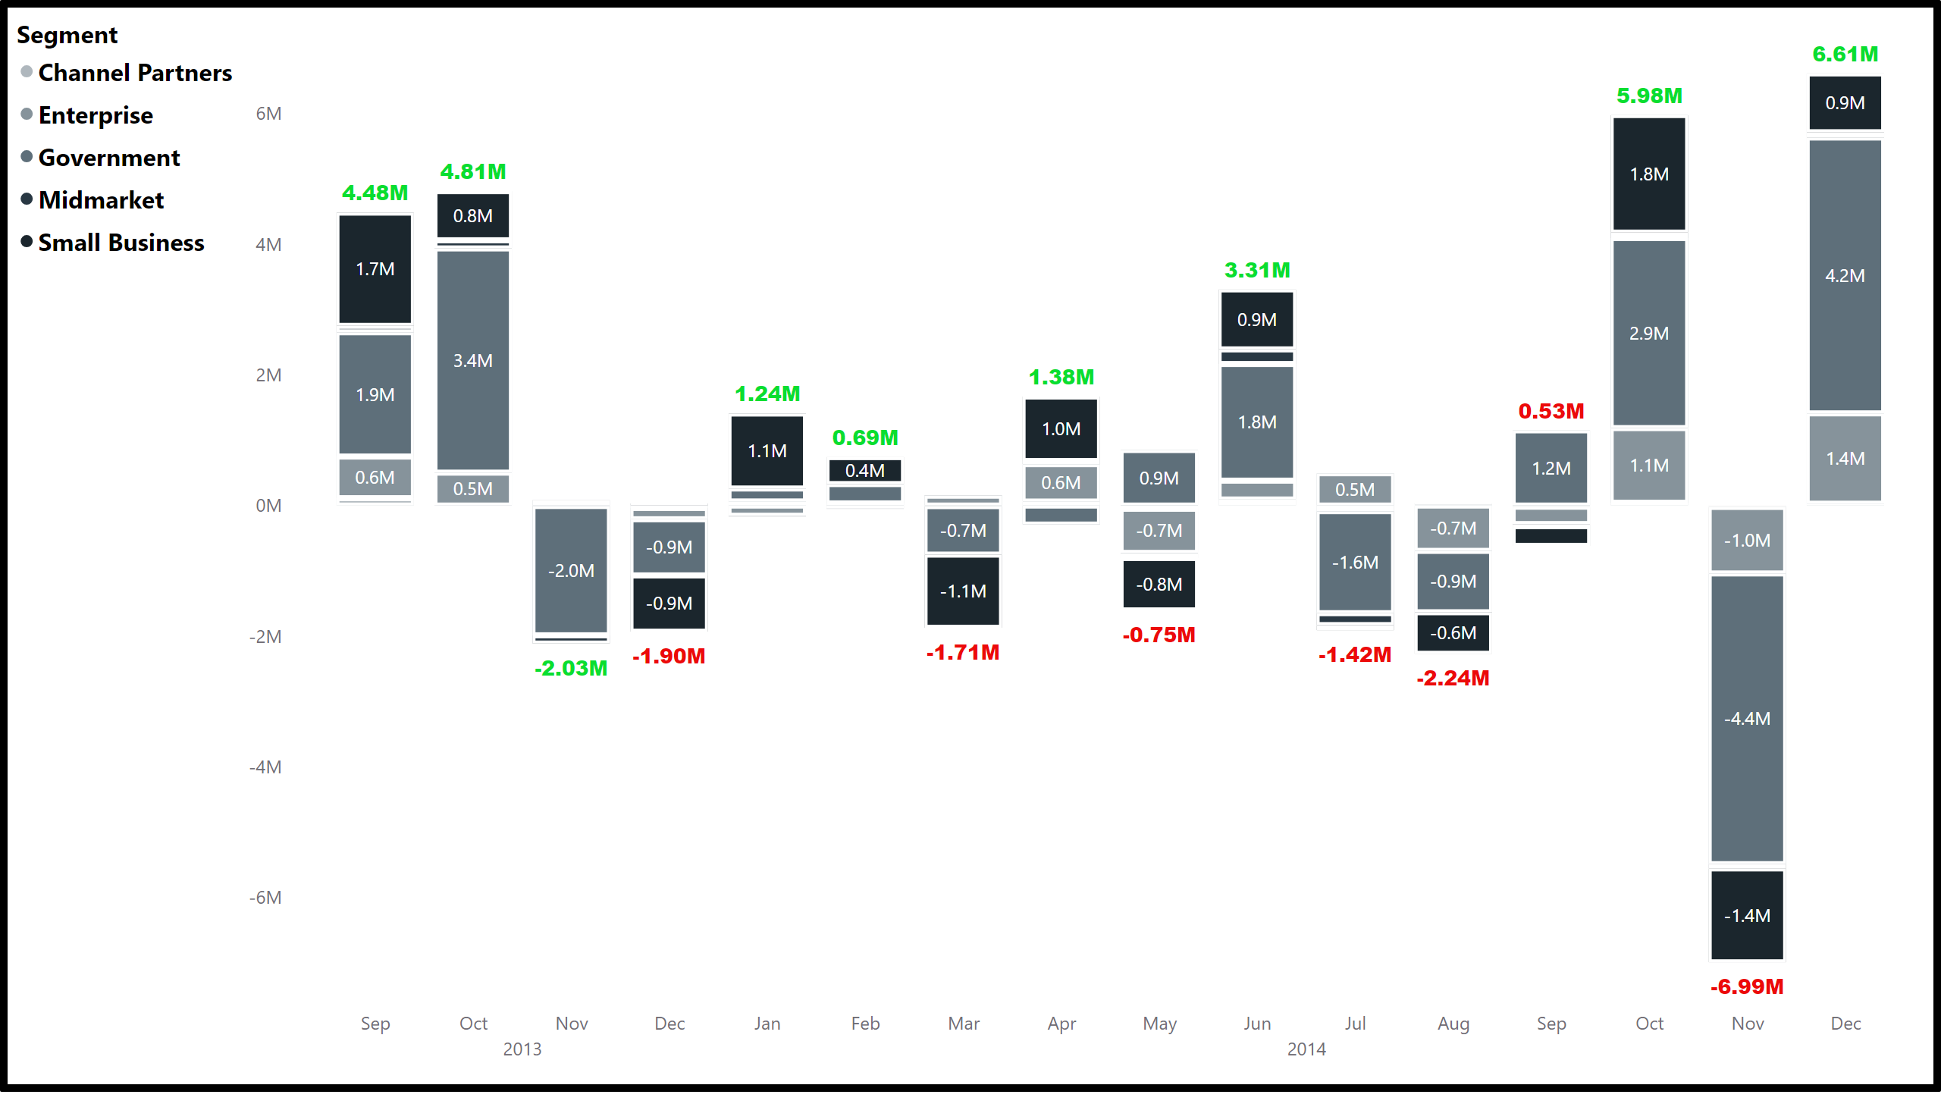
Stacked column chart
Notes:
columnChart
No alt text provided

